Slide 1

STARTER TRAINING
YOUR SUCCESS PLANNING

Slide 2



Success tools
YOUR SUCCESS PLANNING
Roadmap to Success

Slide 3
Checklist for new partners
YOUR SUCCESS PLANNING
The first steps
Registration and initial order (important - the difference between 100 and 485 PV business packages and their advantages explained) completed.
Success planner as soon as available
WHY is defined, added to the Email list and groups on Social Media
Appointment for a training interview arranged, autoactive order explained
Backoffice roughly explained (especially how to sponsor a new partner and place him/her in the binary tree)
Is familiar with the products
Is familiar with the marketing plan
Registration for the next big event
Participation in the zoom conferences and meetings (info via Email, WhatsApp, Telegram)
Create a success plan with the sponsor
Create appointment calendar and schedule time. 10-15 hours per week
Write a name list (at least 100 names)

Slide 4


Your Lavylites Business
YOUR SUCCESS PLANNING
Introduction – The first hours in business
Find your WHY
Set goals
Build up your list of names
Follow up, work continuously and duplicate
PERSONALITY GROWTH & DEVELOPMENT
There are only 2 reasons not to succeed with Lavylites: 1. Never really start 2. Quit too soon

Slide 5
Where are you at?

Slide 6

Your WHY leads you to the HOW!
YOUR SUCCESS PLANNING
It all starts with your wishes …
What if?
„ Our desires are the sensations of the abilities that lie within us, the harbingers of what we are capable of accomplishing. Goethe

Slide 7
Knowing the result
YOUR SUCCESS PLANNING
What exactly do you want?
What does your perfect day look like?
What lifestyle do you aspire to? What does it look like?
Clarity about the goal and the WHY is the fuel for successful actions!
Knowing what you want and charisma is the key!

Slide 8
Contacts
YOUR SUCCESS PLANNING
Who do you know, who do you think about, who do you like?
Who is open and receptive to new opportunities?
Who is looking for new growth opportunities on the personal, the economical and/or health-level?
Who would you like to actively work with?
Who is looking for a change in his/her professional career?

Slide 9

Active contact list
YOUR SUCCESS PLANNING
Networking
How do they recognize your enthusiasm?
Train your “contact muscle“

Slide 10
Contacts
Name | Phone Number | E-Mail | Your WHY | Appointment | 1/1 | Party | Info | Follow up | Registration

Slide 11

Action
YOUR SUCCESS PLANNING
Do few things well and continuously! LET IT FLOW!

Slide 12

Set personal goals
YOUR SUCCESS PLANNING
„Goals give us something we can head for. They bundle our efforts. They enable us to measure our success. Dale Carnegie
What will you achive within 3 months? Write it down!
Partner? Start up? Leader? Team Leader?
2 0 2 2

Slide 13

Success as a team
YOUR SUCCESS PLANNING
Be aware: You do not have to do everything yourself
Surround yourself with like-minded people
Go forward bravely and talk about your dreams
Create a Key Partner Powerteam

Slide 14
The most important skills
Getting to know people
Invite
Present
Follow up
YOUR SUCCESS PLANNING

Slide 15

Enthusiasm
YOUR SUCCESS PLANNING
Enthusiasm is the core of your success!
Enthusiasm is the guarantee that you do something with all of your heart and "burn" for it
Enthusiasm let you experience the joy in doing
„ A person is successful when he does what he likes between getting up and going to bed". Bob Dylan

Slide 16

Inviting guests
YOUR SUCCESS PLANNING
7 % = Words
93 % = Energy
Tips :
Detach yourself emotionally from the result
Be authentic, honest and genuine
Bring in passion & enthusiasm
Be present with your counterpart: What does he need and why can Lavylites be his solution. Recognize the needs!

Slide 17
How to invite
YOUR SUCCESS PLANNING
Who is asking, leads!
„May I invite you, I found out about :
.. an innovative, groundbreaking cell regeneration concept….
…a magical spray with fantastic effects…
…a subtle rejuvenation shower…
… a modern vibrational cosmetic line that restores our inner order, relaxes, rejuvenates, centers.

Slide 18
Presenting
Use the power of the 3rd person (especially in the beginning)!
Invitation regional presentations
Zoom presentation / sending a presentation link
Tools: Telegram and WhatsApp other social media
Invitation to weekly zoom calls - duplication tool
Invitation Events
YOUR SUCCESS PLANNING

Slide 19
Follow up
YOUR SUCCESS PLANNING
Ask questions instead of thinking for others
Feeling good as an inner attitude
What is the best for my counterpart?
What did you like best?

Slide 20
Follow up
YOUR SUCCESS PLANNING
Create commitment
Having team spirit is not selling!
Offering choices free of value:
Do you want to start experiencing Lavylites?
Full price or advantage price?
Do you want to earn money with it?
Point out the importance of the initial order 100 PV / 485/ 970 / 1455 PV

Slide 21
Dealing with Objections
YOUR SUCCESS PLANNING
Too expensive→ I'm glad you brought that up. How do you like it apart from the price?
Would it be interesting if I showed you how you can get it for free?
No time → I'm glad you brought that up – that's why I addressed you

Slide 22

Important principles
YOUR SUCCESS PLANNING
Being a sower - Next please! Keep sowing!
Never let disappointments stop you!
Keep your energy-level up

Slide 23

What if...
YOUR SUCCESS PLANNING
Goal 1: Start in secondary job i.e. 5-10 hours/week; main job to cover living expenses; use side income to build up assets
Goal 2: Side income exceeds main income, i.e. free choice of day / work organization!

Slide 24

SUCCESS PLANNING
YOUR
INCOME

Slide 25



Lavylites as the business opportunity
YOUR SUCCESS PLANNING
Perfect timing
Unique products
AHA effects
Growing health and wellness market
Fair compensation plan
Strong company & worldwide expansion still to come

Slide 26


Lavylites as the business opportunity
YOUR SUCCESS PLANNING
Exclusivity
Consumable products
AHA effects
Unlimited target group
Timing
Growing health, wellness and spiritual market
Fair compensation plan
Strong company & worldwide expansion still to come

Slide 27

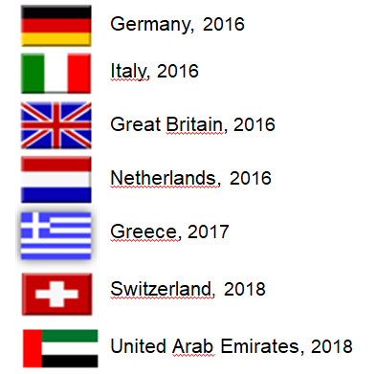


Development 2013 - 2019
YOUR SUCCESS PLANNING
Hungary 2013
Czech Republic, 2014
Poland, 2014
Slovakia, 2014
Romania, 2014
Slovenia, 2014
Croatia, 2014
Austria, 2016
All countries of the
European Community, 2019

Slide 28

2021 Opening of the US – Market
The worlds largest consumer Market
All markets in the America, Asia, Africa and Australia are yet to come
Russia will be relaunched next

Slide 29
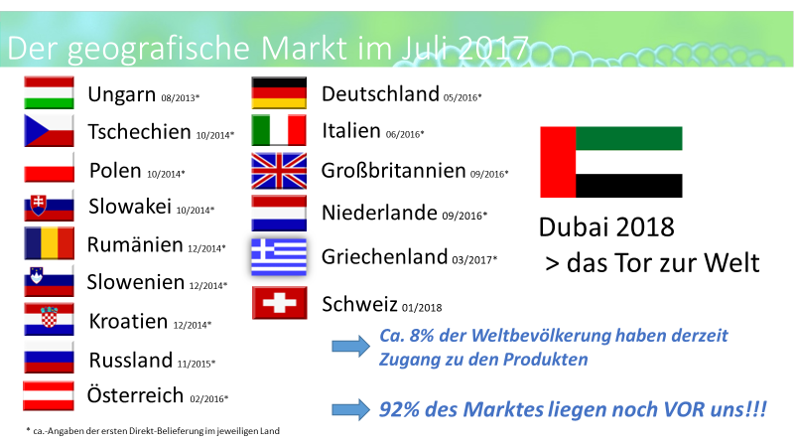



Current Development
Only 8% of the world has for access to our Essences
92% des Weltmarktes liegen noch vor uns
YOUR SUCCSSPLAN
USA, VAE, Kolumbien & über 30 EU LÄNDER

Slide 30
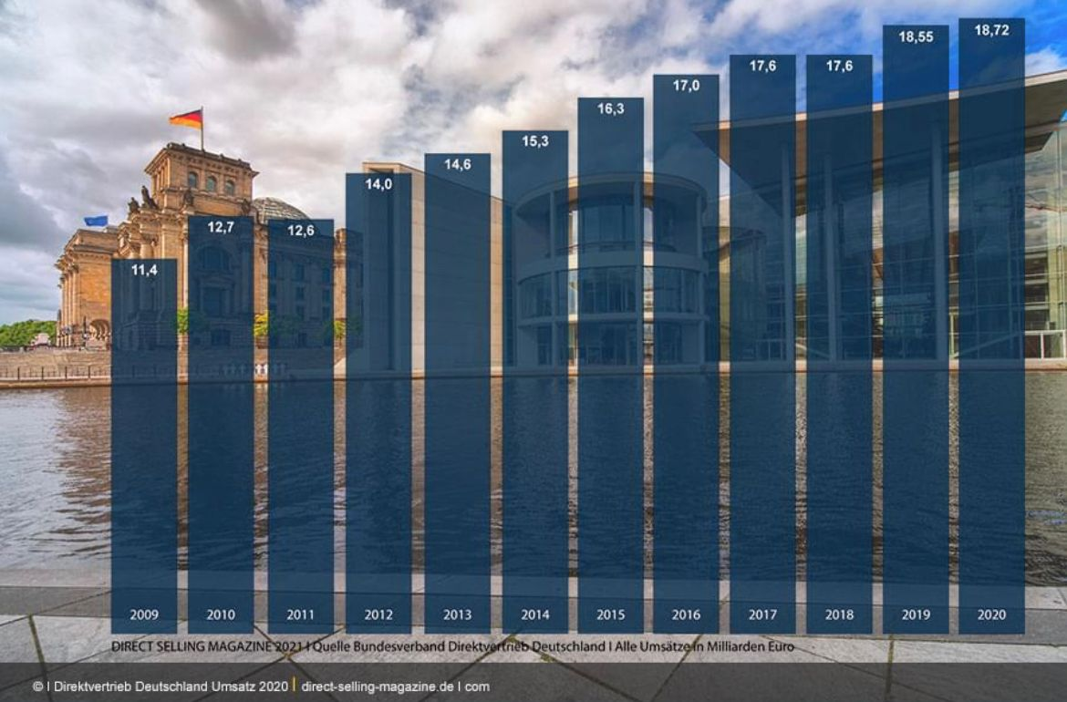
Network Marketing is trendy!
AND THE NEW INDEPENDENCE
In Europe less than 5 % of the trade in goods is moved through network marketing.
In the US and in Asian countries network marketing makes up 20 % to 30 %.

Slide 31
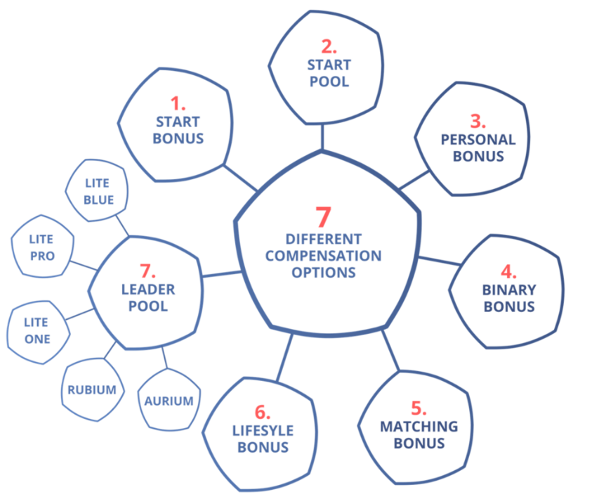


Your income opportunity
PLUS VARIOUS INCENTIVES ACCORDING TO COUNTRIES

Slide 32

8 Income opportunities*
58% OF THE NET PURCHASE PRICE IS GUARANTEED
Retail profit up to 32%
Start-up bonus up to 58%
Personal purchase bonus 20%
Start-Pool 2%
Binary Bonus 10%
Generation Matching-Bonus
Leader Pool 5 x 1%
Partner Lifestyle-Bonus
* with two active partners and monthly: 100 € net (from the position Leader 200 €)

Slide 33


The first steps
YOUR SUCCESS PLANNING
You 100/500/1000/1500 PV
1. Business Partner 100/500/1000/1500 PV
2. Business Partner 100/500/1000/1500 PV
Place initial order for at least 100 PV - Recommendation: Business package for 500 or 1000 or 1500 PV
Apply products yourself and distribute them
Gather experiences and exchange ideas
Enroll 2 people who are doing the same
Place an Autoactive order for a minimum of 100 PV every 28 days
Repeat this process at least 4 times

Slide 34

The perfect Start
Starting with a Business-Pack, you receive 3 (!) business positions in the marketing plan, (at 25,000 € total sales in the lesser leg) i.e. you can triple the income out of the binary bonus up to 30,000 € / week!
Min. 100 PV 1 business position
1
Min. 500 PV Business-Pack 3 business positions
2
3
Notes:
The company rewards starting with a business pack with 2 supplementary positions in the marketing plan, that will open up when you have reached the amount of 25,000 € in total sales in your weaker leg in 4 subsequent weeks

Slide 35

How can I succeed?
YOUR SUCCESS PLANNING
Enroll 2 people and help them also to enroll 2 people
Focus on team members – the power of duplication

Slide 36
What’s a partner?
YOUR SUCCESS PLANNING
PARTNER
SALES:
500 PV
SALES:
500 PV
ACTIVE = Personal order of 100 PV every 28 days

Slide 37
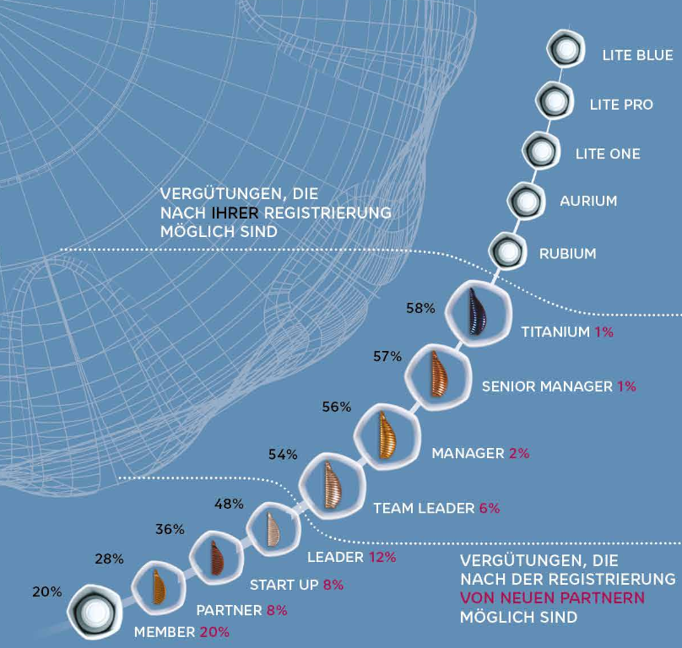
Start-up bonus up to 58%
THE FIRST STEP TO THE REALIZATION OF YOUR DREAMS
This compensation applies to the first order of newly enrolled customers / partners
A payout of 58% on initial orders is guaranteed, distributed on a differential basis according to the positions held, every week. The Minimum for the sponsor is 20%
Qualification requirement: at least 100 PV (starting position Leader 200 PV) personal purchase in 28 days
If the qualification is missing, the Start-up bonus will be added to the Matching bonus
Differential payment depending on the position!

Slide 38
Start-up bonus 20-58 %
CALCULATION EXAMPLE
Condition: personal activity in 28 days (100 PV / starting Leader 200 PV)
On all initial orders of your new partners
Differential commission on partners of your direct team partners
Depending on the position achieved (Member, Partner, Startup, ...)
Example: Business package = 500 € net
Sponsor (You) 20 % = 100,0 € net
Partner + 8 % = 40,0 € net = 140,0 € net
Start up + 8 % = 40,0 € net = 180,0 € net
Leader + 12 % = 60,0 € net = 240,0 € net
Team-Leader + 6 % = 30,0 € net = 270,0 € net
Manager + 2 % = 10,0 € net = 280,0 € net
Senior-Manager + 1 % = 5,0 € net = 285,0 € net
Titanium + 1 % = 5,0 € net = 290,0 € net

Slide 39

Start Pool
REVENUE SHARE
Lavylites places 2% of the worldwide reoccuring sales into the Start Pool
Each sponsor of a new member that orders at least 100 PV receives ½ share of this Pool
Only full shares are paid out
This Bonus only applies up to the Leader position
Become a part of the Lavylites Family!
Min. 100 PV
Min. 100 PV
2 new members = 1 share

Slide 40
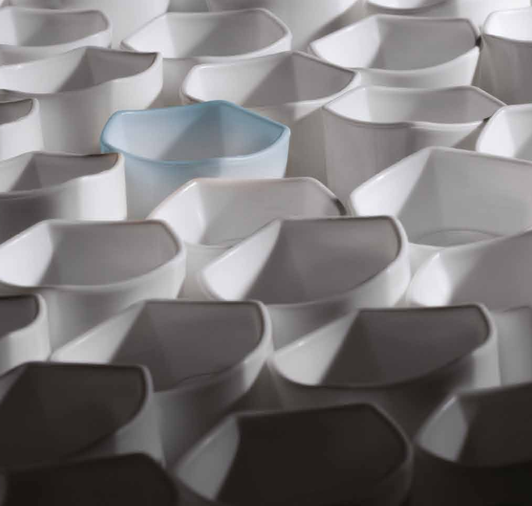
Personal Bonus
YOUR PERSONAL PROFIT
You will receive a 20 % refund for all PV points above 100 PV, if you place your own order in Autoactive. The bonus applies for each additional order in the current 28 day activity period.
Example:
Place an order for 200 PV using
autoactive, and receive a rebate
of 20 PV (20% out of 100 PV)

Slide 41
Autoactive orders
YOUR SUCCESS PLANNING
Place orders with autoactive system
Personal Bonus (20 % on orders exeeding 100 PV / 28 days) only available when using Autoactive
Helps you to:
Secure continuous accumulation of CV‘s
Continuous participation in the car bonus program/ if applicable
There is no automatic subscription, as long as the credit card is not saved

Slide 42
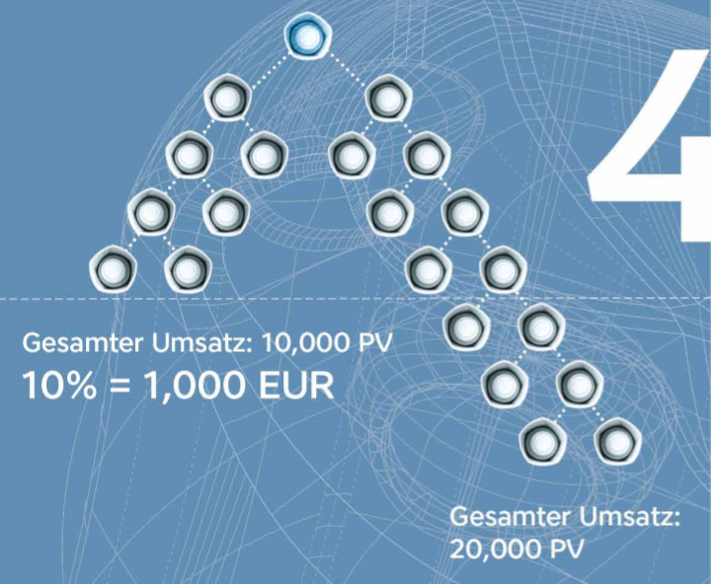
Binary bonus
CONSISTENCY AND STABILITY
You will receive a weekly payout of 10% of the sales of the weaker leg in your binary tree (max. 10 000€ / week)
The difference remains in the stronger leg as CV‘s and accumulates
Qualification requirement: at least 100 PV (starting position Leader 200 PV) personal purchase in 28 days and one directly sponsored active team member on each side

Slide 43
Qualification
PERSISTANCE AND STABILITY
MANAGEMENT LEVELS | VALUE OF THE ACTIVITY (PV) | SALES ON THE WEAKER SIDE (QV) | DIRECT PARTNER | IN BINARY TREE
LITE BLUE | 200 | 500.000* | 8 | Direct partners and networkers on both sides
LITE PRO | 200 | 250.000* | 8 | Direct partners and networkers on both sides
LITE ONE | 200 | 105.000* | 8 | Direct partners and networkers on both sides
AURIUM | 200 | 50.000* | 8 | Direct partners and networkers on both sides
RUBIUM | 200 | 25.000* | 7 | Direct partners and networkers on both sides
TITANIUM | 200 | 13.750* | 6 | Direct partners and networkers on both sides
SENIOR MANAGER | 290 | 8.750* | 5 | Direct partners and networkers on both sides
MANAGER | 200 | 5.000* | 4 | Direct partners and networkers on both sides
TEAM LEADER | 200 | 3.125* | 3 | Direct partners and networkers on both sides
LEADER | 200 | 1.875* | 2 | Active direct Team Member 100-100PV on each side
START UP | 100 | 1000* |  | Active direct Team Member 100-100PV on each side
PARTNER | 100 | 500* |  | Active direct Team Member 100-100PV on each side
MEMBER | 50
*According to the binary structure

Slide 44

Your Lavylites
YOUR SUCCESS PLANNING
2
x2
=4
x2
=8
x2
=16
30
3
x3
=9
x3
=27
x3
=81
120
4
x4
=16
x4
=64
x4
=256
424
5
x5
=25
x5
=125
x5
=625
780
Example:
Ø 100 €
Monthly sales 7%
Compensation
3.000 x 7%
= 210 €
12.000 x 7%
= 840 €
42.400 x 7%
= 2.968 €
78.000 x 7%
= 5.460 €

Slide 45


DUPLICATABLE BUSINESS
WHAT DO YOU THINK IS POSSIBLE WHEN YOU ENROLL 1 PERSON PER MONTH AND THEY DO THE SAME THING YOU DO MONTH AFTER MONTH?!
4096 TEAMMEMBER = 20480€
2
32
512
4
64
4096
2048
8
1024
128
16
256

Slide 46

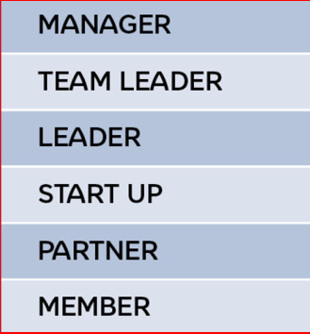
Income opportunities
YOUR SUCCESS PLANNING
7.500 – 15.000 EUR / week
(after > 3 years)
.
.
.
1.125 – 1.750 EUR / week*
625 – 1.625 EUR / week*
375– 1.000 EUR / week*
0 – 375 EUR / week*
0 – 250 EUR / week*
0 – 187 EUR / week*
*:without spill-over

Slide 47
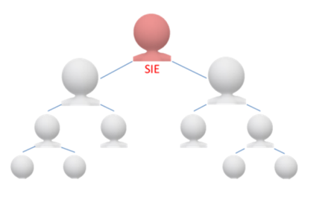
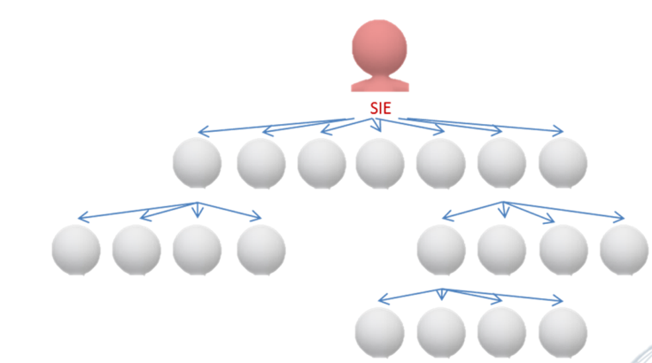
Your Lavylites
YOUR SUCCESS PLANNING
Binary plan
Uni-Levelplan
.
Lavylites has unique products and also a streamlined and efficient marketing plan that provides enormous benefits to all partners through its dual payout system (binary and unilevel).

Slide 48
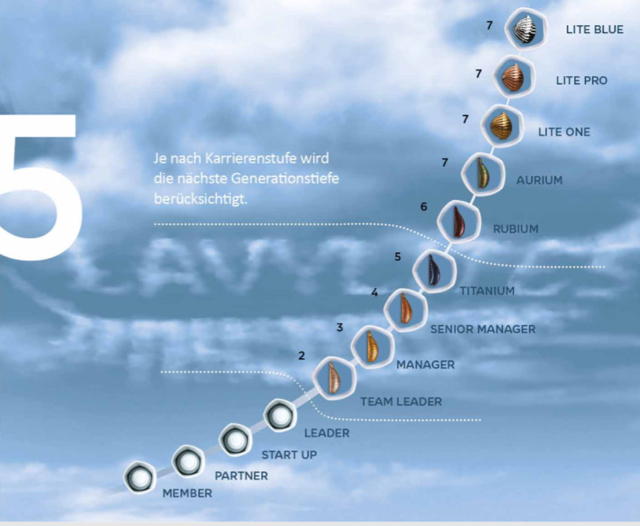
Matching Bonus
YOUR PROVISION ON TOP
Redistribution of Bonuses with missing qualifications, in order to guarantee a payout of 58%
Starting with the position of Team Leader (200 PV personal orders in 28 days) you are entitled to the Matching Bonus, which is calculated up to 7 generations
A generation is always counted to the next qualified leader

Slide 49
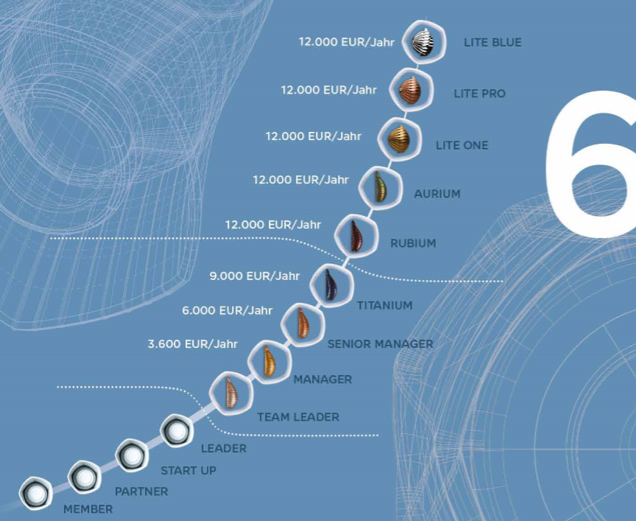
Lifestyle Bonus
SUCCESSFUL MANAGEMENT IS REWARDED
Starting from the position manager you will receive a Lifestyle Bonus which is paid out weekly.
The Prerequisite is qualifying four times in a row for the individual position
Manager: 300 € / month
Senior Manager: 500 € / month
Titanium: 750 € / month
Rubium: 1000 € / month

Slide 50
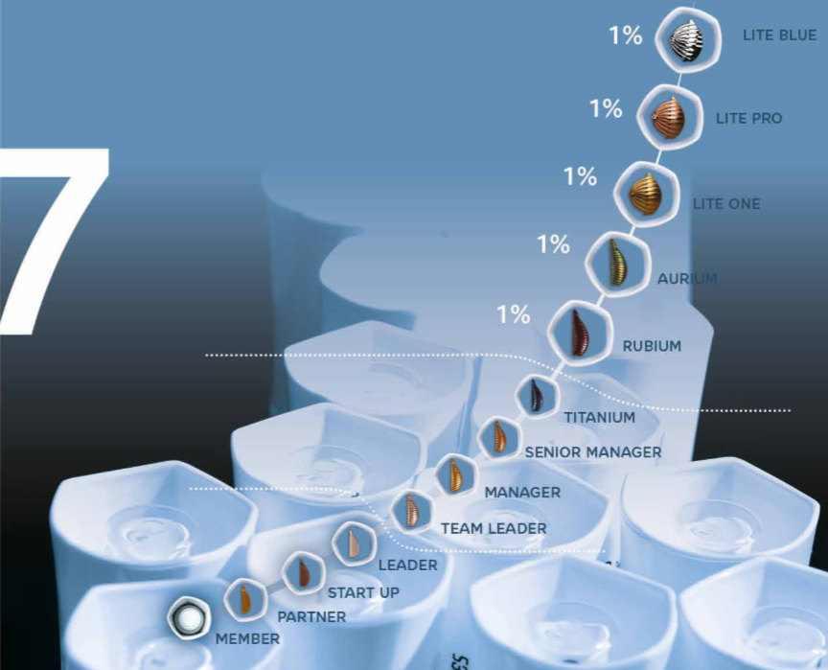
Leaderpool
MANAGEMENT BONUS – 5 x 1%
5% of the weekly reoccuring sales are distributed through the Leader Pool.
Starting from the position Rubium to Lite Blue 1% is shared by all persons that earned this position in that week

Slide 51
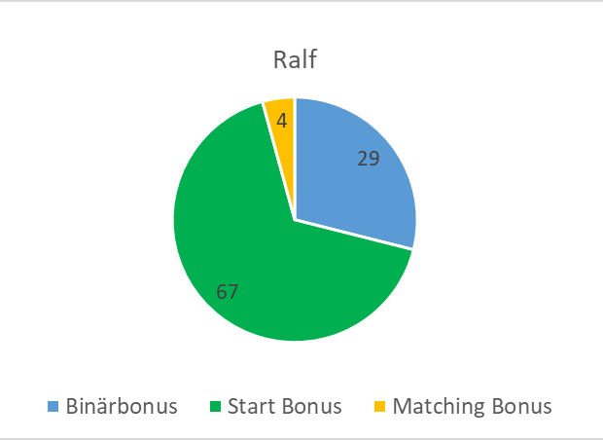
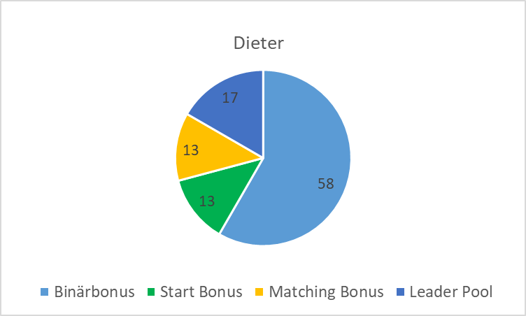
Bonus distribution
YOUR SUCCESS PLANNING
STARTBONUS dominates at the beginning
BINARY BONUS grows slowly but steadily
MATCHING BONUS from TEAMLEADER
is growing slowly at first, but has the greatest potential of all bonuses
LEADER POOL from RUBIUM
Participation in the global success of the company
MANAGER
- Bonus: 1.500/week -
AURIUM
- Bonus: 15.000/week -

Slide 52
Success as a team
YOUR SUCCESS PLANNING
Be aware: You do not have to do everything by yourself
Surround yourself with like-minded people
Go forward bravely and talk about your dreams
Create a Key Partner Powerteam

Slide 53
The magical 1000
YOUR SUCCESS PLANNING
"Present your business to 1000 people in the next 2-6 years!" Michael Strachowitz

Slide 54


